Slide 1
Why stratified sampling is superior

Slide 2
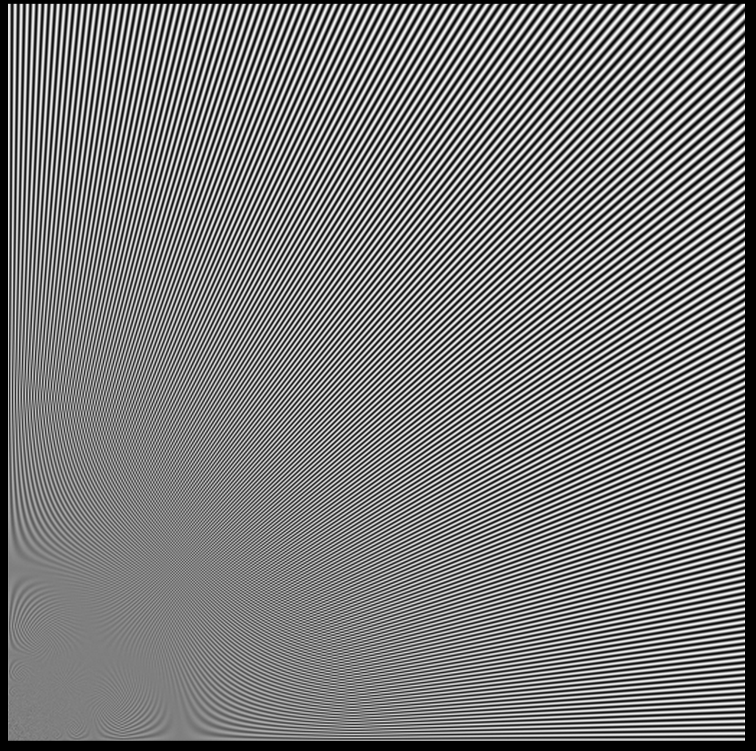
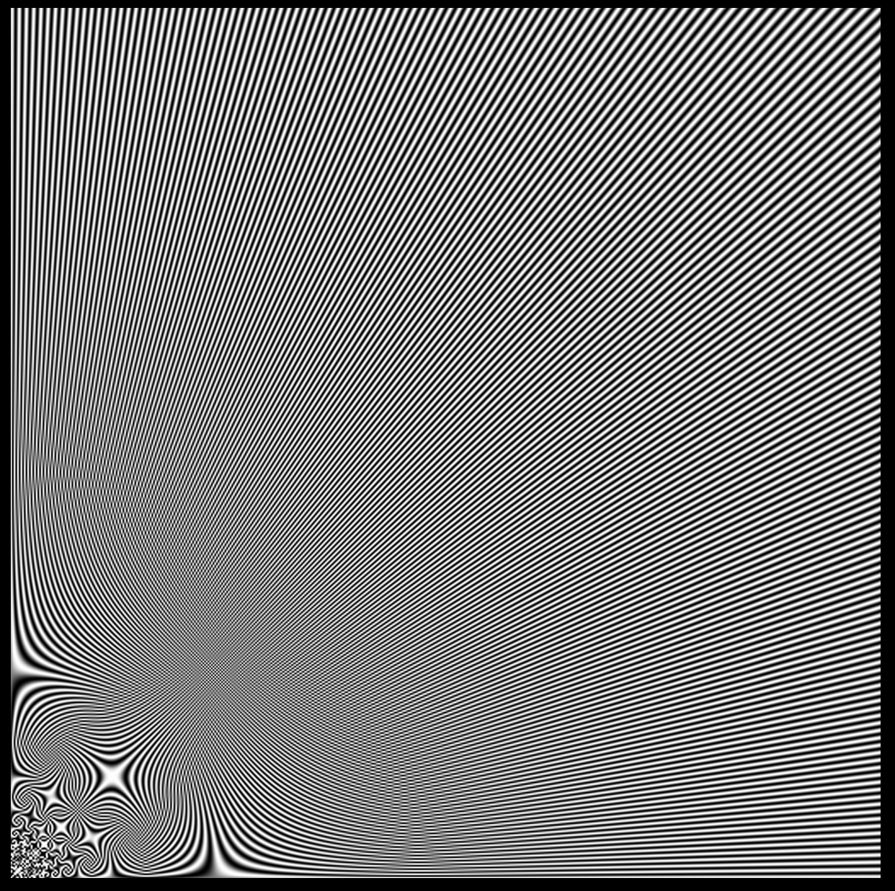
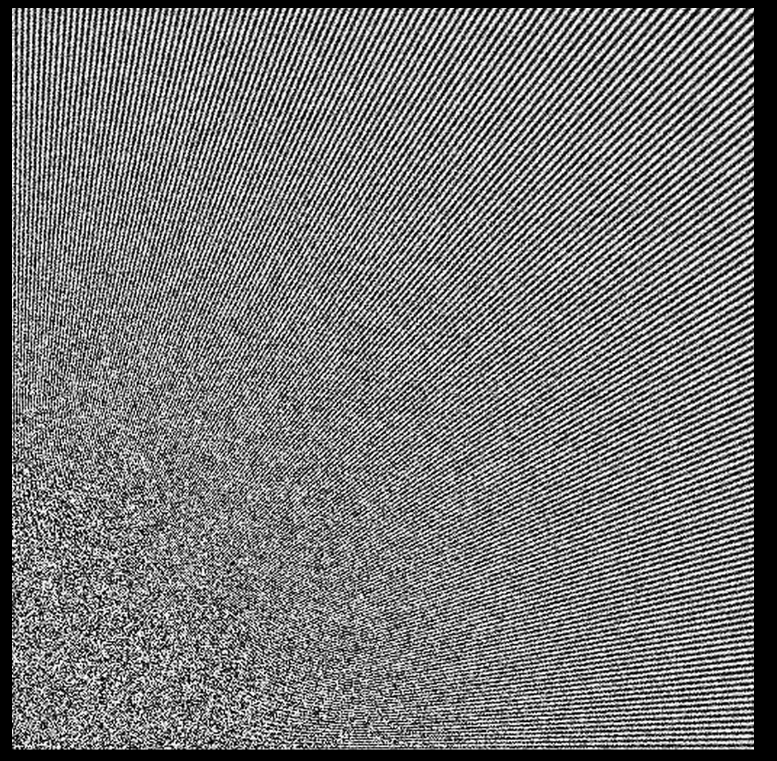
Stratified is better than regular sampling
On the left the “original image” is shown with many samples.
In the center the image with one regular sample is shown, on the right it is shown with stratified sampling.
As can be seen the regular sampling produces a lot of aliasing, which is not the case for stratified sampling.

Slide 3
Stratified is better than regular sampling
On the left the “original image” is shown with many samples.
In the center the image with one regular sample is shown, on the right it is shown with stratified sampling.
As can be seen the regular sampling produces a lot of aliasing, which is not the case for stratified sampling.
Aliasing
No Aliasing

Slide 4
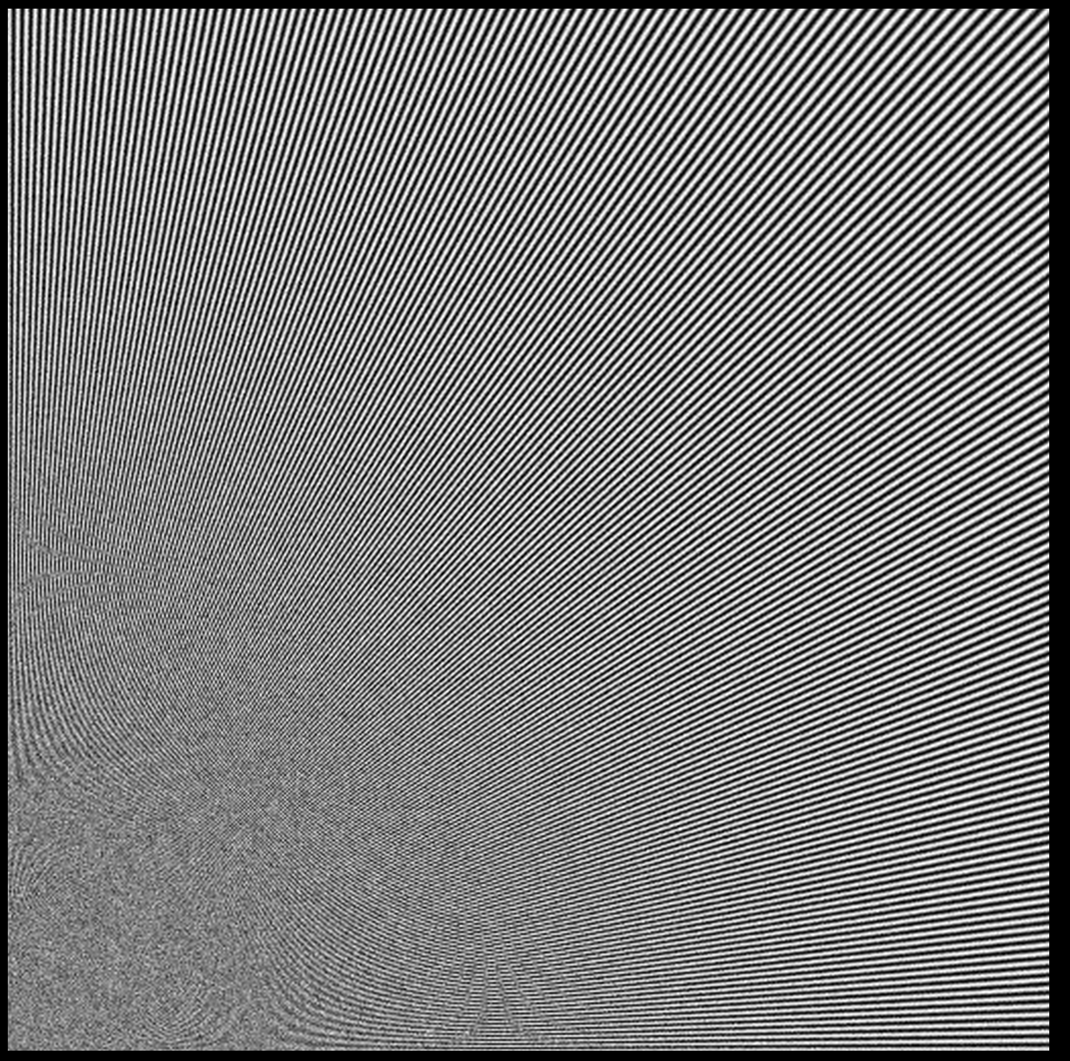
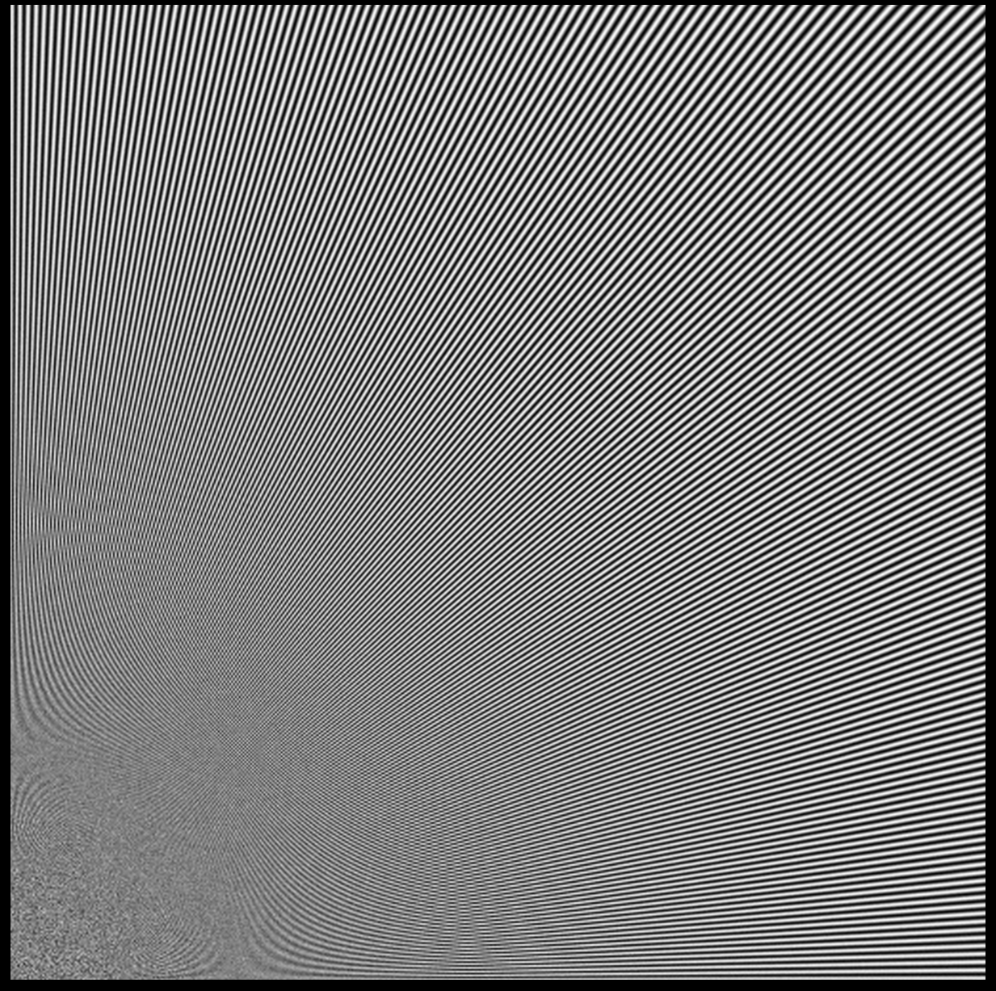
Stratified is better than random sampling
On the left the “original image” is shown with many samples.
In the center the image with 16 random samples is shown, on the right it is shown with 16 stratified samples.
As can be seen the random sampling produces much more noise than the stratified sampling

Slide 5
Stratified is better than random sampling
On the left the “original image” is shown with many samples.
In the center the image with 16 random samples is shown, on the right it is shown with 16 stratified samples.
As can be seen the random sampling produces much more noise than the stratified sampling
Noise
No Noise

